Slide 1
Where’s Waldo Wildfire?
Image Recognition
Kai Mazurczyk, Travis Mark, and Brittany Laurent

Slide 2

Where’s Waldo?
Who’s Waldo?
Where’s Waldo is a series of children’s puzzle books filled with complex illustrations that are designed to keep readers engrossed with finding the main character Waldo. Wearing a red and white striped shirt, knit hat and round glasses, Waldo is tucked into varying scenes amidst crowds of other characters and repeated patterns, with different size and placement in each image.
Problem Statement:
Our goal is to construct a Convolutional Neural Network to accurately identify where Waldo is in these images.

Slide 3

Waldo Thumbnails
Image set contained 5,376 64x64 color images
Data was highly imbalanced with Waldo class being less than 1%. Only 39 images contained Waldo
Performed image augmentation on the Waldo images, by flipping and rotating, to reduce imbalance of the classes. Increased Waldos to 3%.
Used Recall as metric to measure model ability to correctly identify Waldo and reduce impact of imbalance.
We took the average pixel for red, green, and blue across the images. Non-waldos appeared better mean distributed but that may be due to the larger size of the dataset
Trained Means, K-Nearest Neighbors, and XGBoost models. None of these simpler methods yielded meaningful results
The more complex and powerful ResNet CNN architecture was only able to achieve 40% recall.

Slide 4
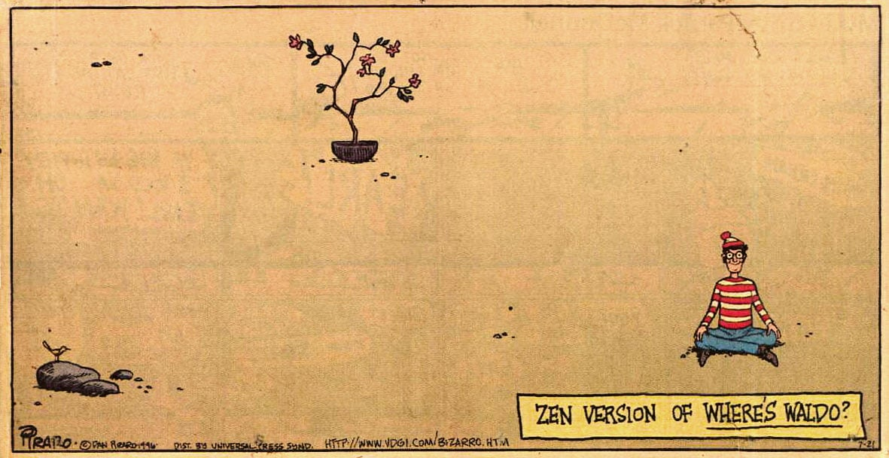
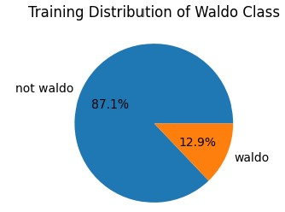
Larger Waldo Images
Moved to a set of 1,344 128x128 pixel images, with 27 Waldos. Reduced imbalance after augmentation, to 13% Waldo class.
XGBoost model continued to be ineffective, 10% recall
ResNet50 model achieved 60% recall on validation images.

Slide 5

Waldo Conclusion
The 64x64 thumbnail images were too imbalanced and the high powered ResNet architecture did not have enough images of the Waldo class to learn from.
Using the larger images reduced the imbalance, but ResNet continued to underperform expectations.
Determined our image data contained too few Waldo images in order for the CNN to properly learn the Waldo features.

Slide 6
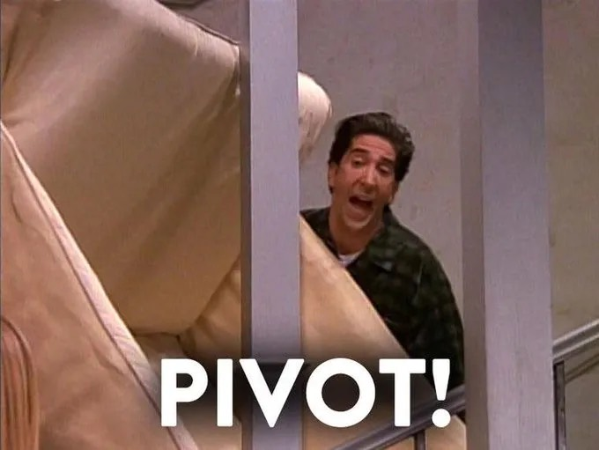
By design of the problem there are a finite number of Waldo images.
Sought to find a different, but similar, problem and set of images to solve.
To show the viability of the CNN to solve Waldo, given enough images.
New problem should seek to classify a broad range of noisy aerial or landscape images.

Slide 7
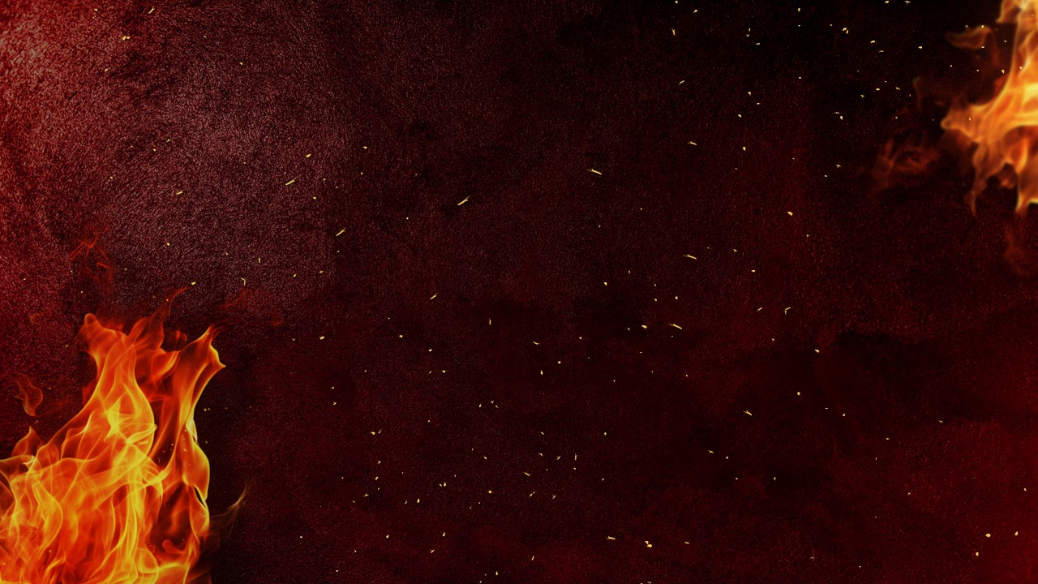
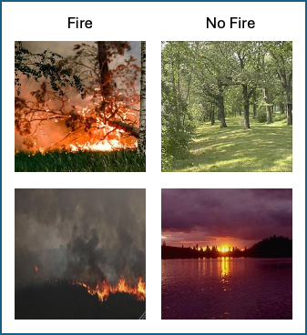
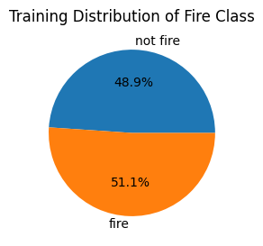
Wildfire or No Wildfire
Balanced, Clear and Distinct Classes

Slide 8
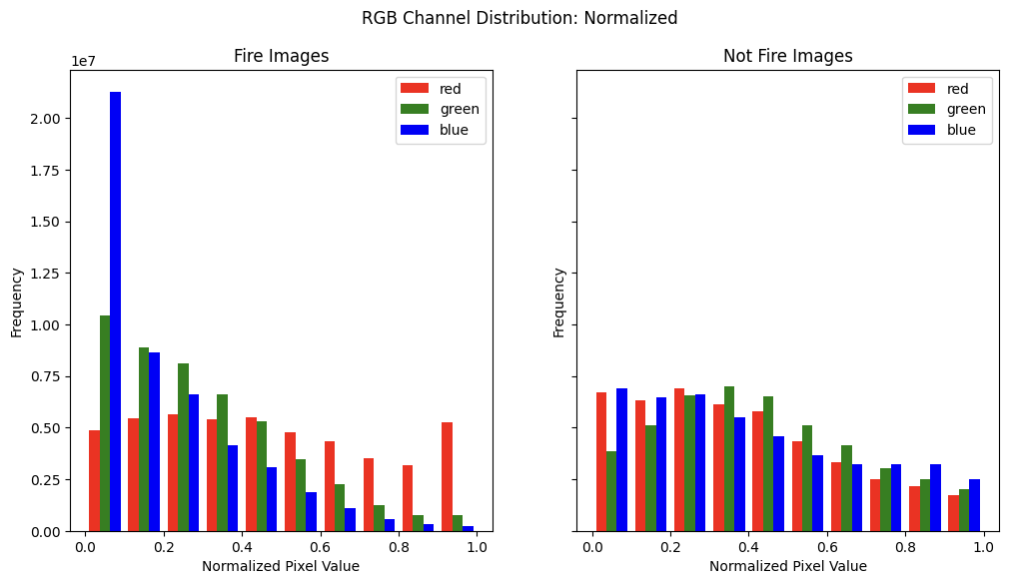
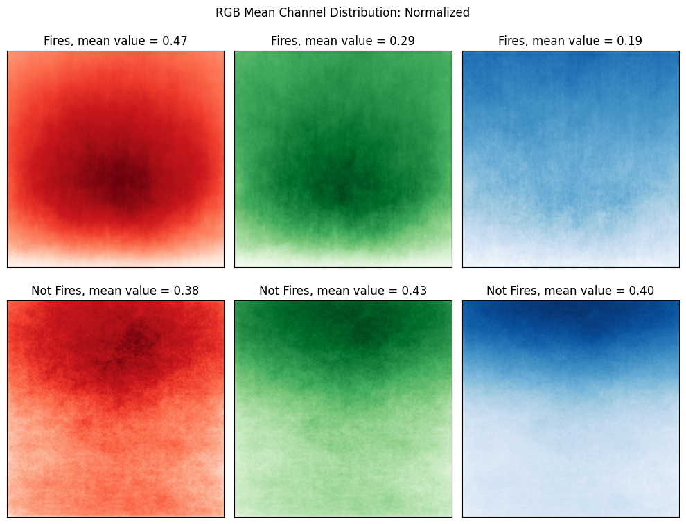
Wildfire or No Wildfire
Balanced, Clear and Distinct Classes
Heatmap: mean RGB pixel values and their location in the image

Slide 9
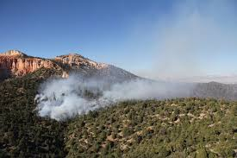
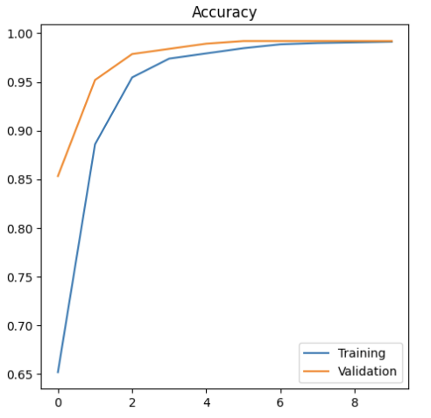
Wildfire Baselines
Training the XGBoost model produced an accuracy of 77%
ResNet achieved 99% on validation images
Our goal is to construct our CNN to achieve accuracy in this range.

Slide 10
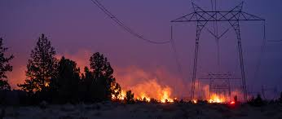
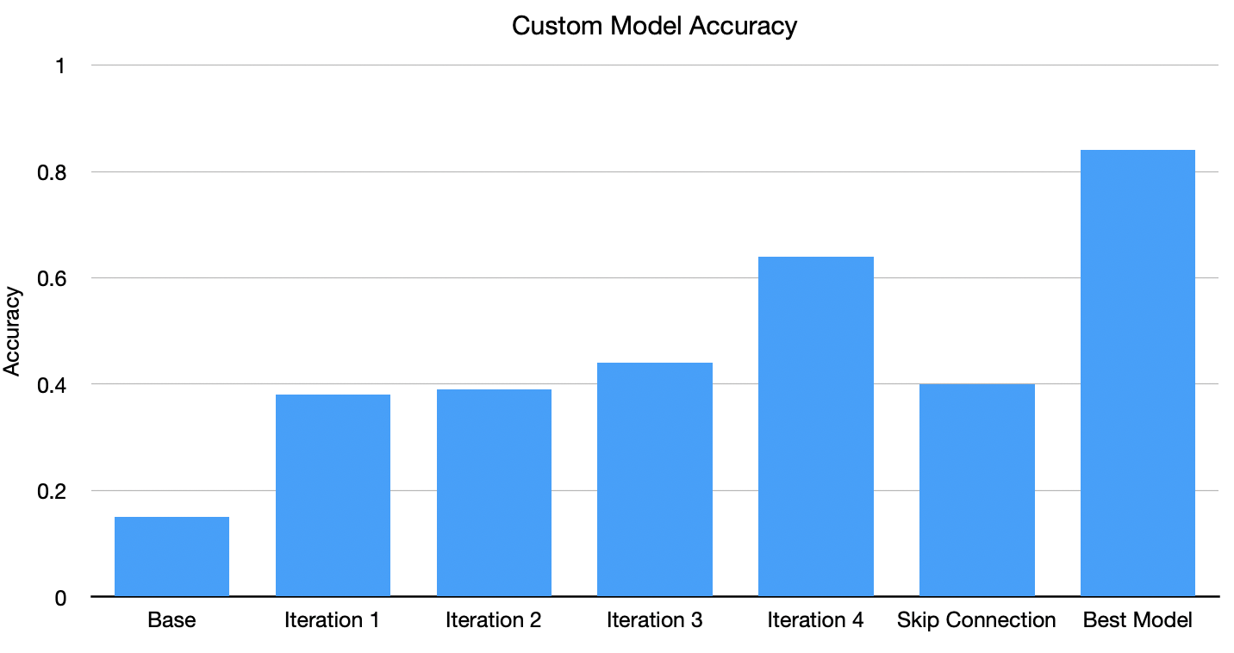
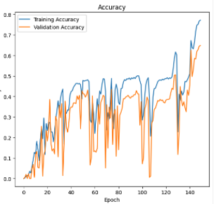

Custom Model Creation
Began with a single convolutional layer model. Unsurprisingly, this model underperformed, reaching only 15% accuracy.
Through the next iterations, we aimed to increase the capacity for the model to learn through:
Adding additional convolutional layers
Increasing filters in convolutional layers
Adding padding
Dropout in dense layers
Increasing size of dense layers
Introducing skip connections
We found dropout helped prevent the model from decreasing loss too quickly and allowed the model to learn longer through back propagation.

Slide 11
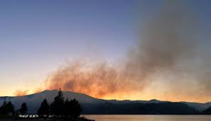
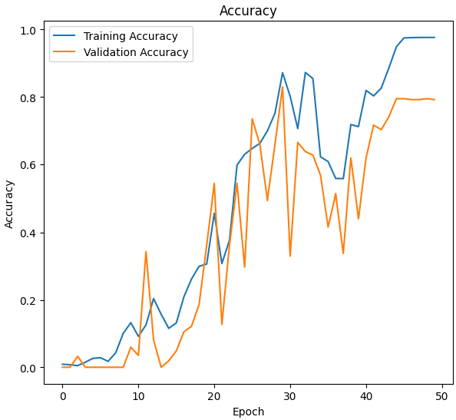
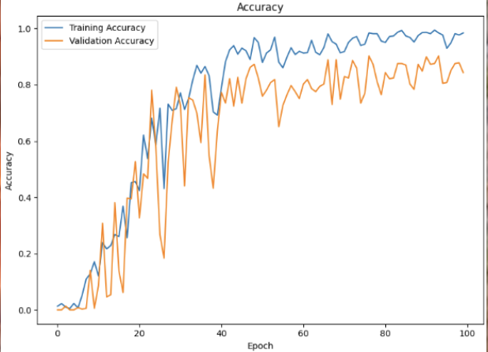
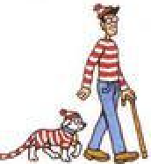
Iteration 5
Larger kernel sizes to allow the model to construct more broad features to learn from
Increase neurons in the first dense layer to 1024
RMSProp optimizer to speed up the training and reduce the impact of momentum on the learning rate
167 million parameters, 10 times the base model
Model reached 80% accuracy on validation.
Proceeded to try refining this model by:
L2 regularization in dense layers - 40%
Adam Optimizer - <10%
30% dropout in dense layers - 84%
Ultimately, adding dropout improved the validation accuracy and was selected as out best model

Slide 12
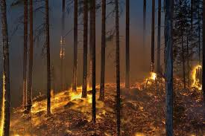
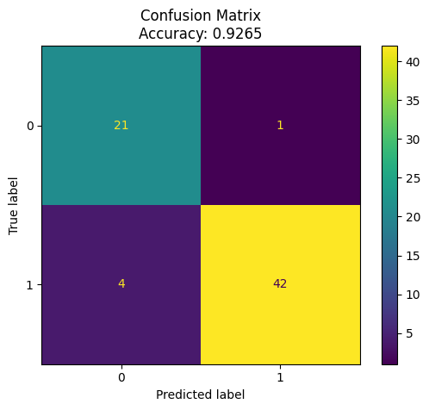
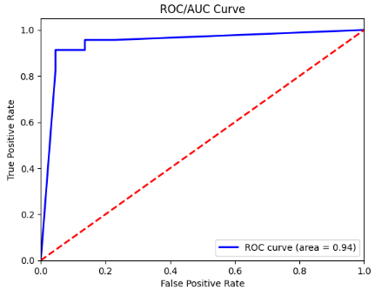

Evaluation of Best Model
Model 5 with the dropout
Predicted on the 68 unseen test images with an accuracy of 92.7%
5 misclassifications on this test data
ROC/AUC of 0.94. Model successfully differentiates between the two classes

Slide 13
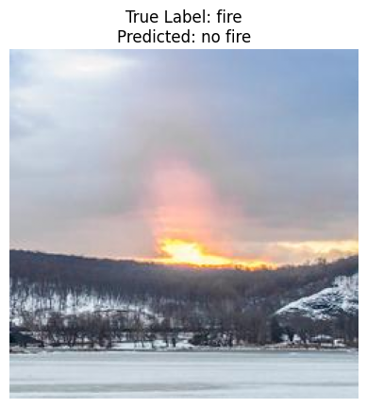
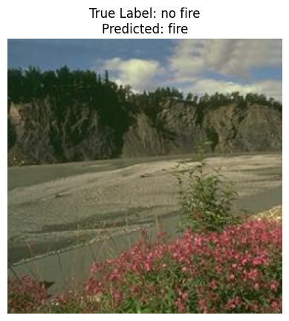
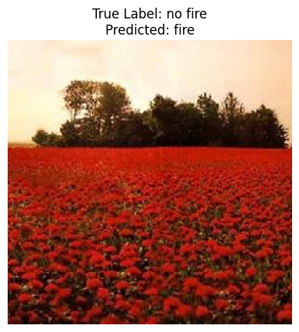
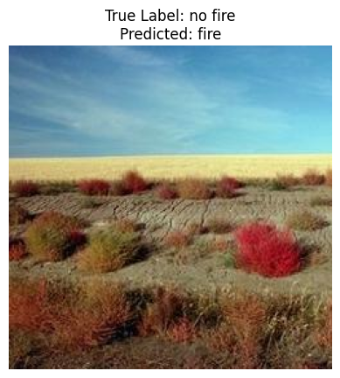
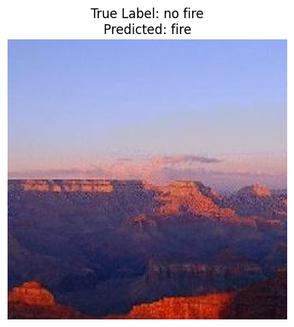
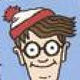
Error Investigation
The four images to the left all have patches of orange, red, or pink in a concentrated areas (3 of which are flowers or plants). Therefore, the model may be construing that to resemble fire
The image on top that was misclassified could easily be misconstrued as a sunrise.
To remedy the errors, we would get additional images of plants/flowers in red/orange hues classified as no fire and provide them to the model for further training to learn more between flowers of these colors and fire

